Slide 1

Software Development in History
By Corey Crooks

Slide 2

What did software look like early on?
Tom Kilburn wrote the first piece of Software by using a series of bits sent to an address in the machine.
Human-Readable syntax didn’t come along until 1957, with the creation of the first higher-level programming language—Fortran.
Personal computing in the 1970s and onward revolutionized the Software development industry by vaulting computing into the houses of families across the globe.
In the year 2000, C# was developed.

Slide 3
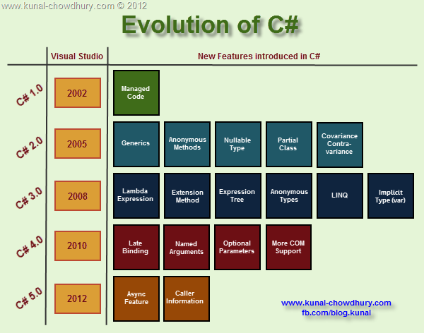
C# Software trends back then
Starting as a viable alternative to Java on Windows, C# back then was feature starved, but still capable.
Started out with the basics: classes, loops, conditionals, variables and more.
Programs were much more verbose. Without the Quality-Of-Life features of today, programmers needed to write much more for their Software.
Continued to expand throughout the decades.
https://www.google.com/url?sa=i&url=https%3A%2F%2Fwww.kunal-chowdhury.com%2F2012%2F07%2Fevolution-of-c-10-50-what-are-new.html&psig=AOvVaw11kuMxGbyLMol9WIvq2Amu&ust=1623118181103000&source=images&cd=vfe&ved=0CAIQjRxqFwoTCKCkzMe4hPECFQAAAAAdAAAAABAD

Slide 4
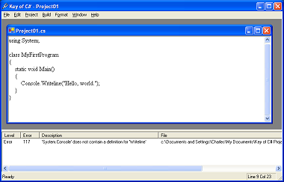
C# Now
Object Orientation still plays a big part in programming today.
Syntax still looks very similar.
Support for new technologies that are developing currently.

Slide 5

Culture in Development
Humans by nature are a social species.
Multiculturalism has and will exist to thrive in software development.
NASA embraces people of all backgrounds.
Microsoft makes it their mission to recruit many different types of people.
https://www.google.com/url?sa=i&url=https%3A%2F%2Ftechbeacon.com%2Fapp-dev-testing%2Fessential-guide-hiring-diverse-development-teams&psig=AOvVaw1KuSTr-F5dp572ew4k5BdX&ust=1623120758690000&source=images&cd=vfe&ved=0CAIQjRxqFwoTCPDF2KDDhPECFQAAAAAdAAAAABAD

Slide 6

Pros of More Culture
Increasing diversity will help you see problems through more people’s perspectives.
Increasing perspectives will help
accommodate more development trends,
and help build a more creative and unique
product.
More culture in your team can help you
reach more clients.
https://media.bizj.us/view/img/10492195/screen-shot-2017-06-07-at-64726-pm*1200xx1251-704-0-104.png

Slide 7

Cons of More Culture
Cultural barriers (language, religion, other practices)
More perspectives can lead to a clash amongst workers.
Encouraged feedback may lead to an oversaturation of it.
https://hrexecutive.com/wp-content/uploads/2018/11/WorkFight700-700x451.jpg

Slide 8
Possible Solutions
Create a more understanding environment for moral or religious complications.
Focus on communication. Everyone must feel like their voices are heard.
Be honest. It will help immensely if your team can say exactly what they think without worry.
Be clear. Your team needs to understand what’s happening and why.
Be supportive. Everyone needs to know what to do if they have a problem.

Slide 9
References
Beladiya, K. (2019, December 12). .NET Trends to Dominate in 2020: Top Frameworks For Web Development. Retrieved
from The One Technologies: https://theonetechnologies.com/blog/post/microsoft-net-core-and-web-trends-to-dominate-
in-2020
erikdietrich, B. Y. (2020, April 8). The History of C#. Retrieved from Microsoft.net: https://docs.microsoft.com/en-us/
dotnet/csharp/whats-new/csharp-version-history
Microsoft. (2021, June 6). Global Diversity and Inclusion. Retrieved from Microsoft.net: https://www.microsoft.com/en-us/
diversity/default.aspx
Pluralsight. (2019, May 15). Everything you need to know about C#. Retrieved from Pluralsight.com: https://
www.pluralsight.com/blog/software-development/everything-you-need-to-know-about-c-
Shea, G. (2020, October 8). Diversity & Inclusion. Retrieved from NASA.gov: https://www.nasa.gov/offices/odeo/diversity-
and-inclusion
Tootill, G. (2021, June 6). The Original Original Program. Retrieved from CCS: http://www.cs.man.ac.uk/CCS/res/res20.
htm#e
Yost, M. (2018, January 25). A Brief History of Software Development. Retrieved from Medium.com: https://medium.com/
@micahyost/a-brief-history-of-software-development-f67a6e6ddae0

